Slide 1
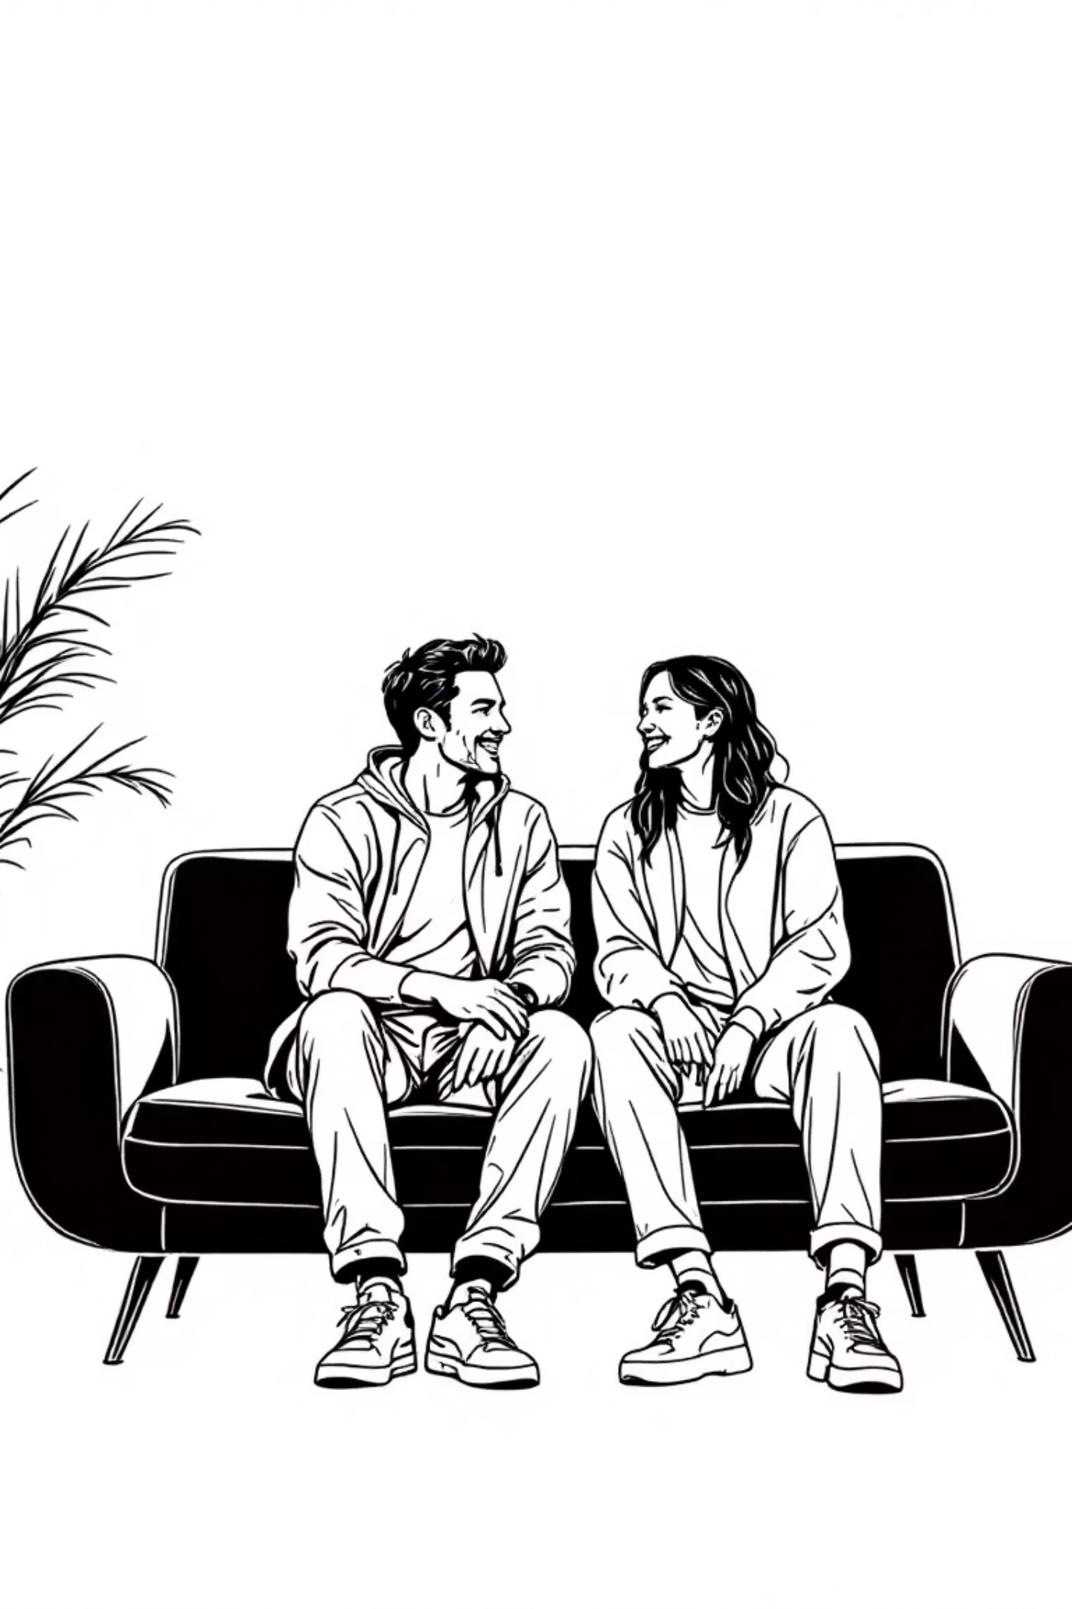
GOODWORDS
Making the Internet Respectful
A Hackathon Project by:Tanveer Singh, Jashandeep Singh, Harnaz Kaur, Udaiveer Singh

Slide 2
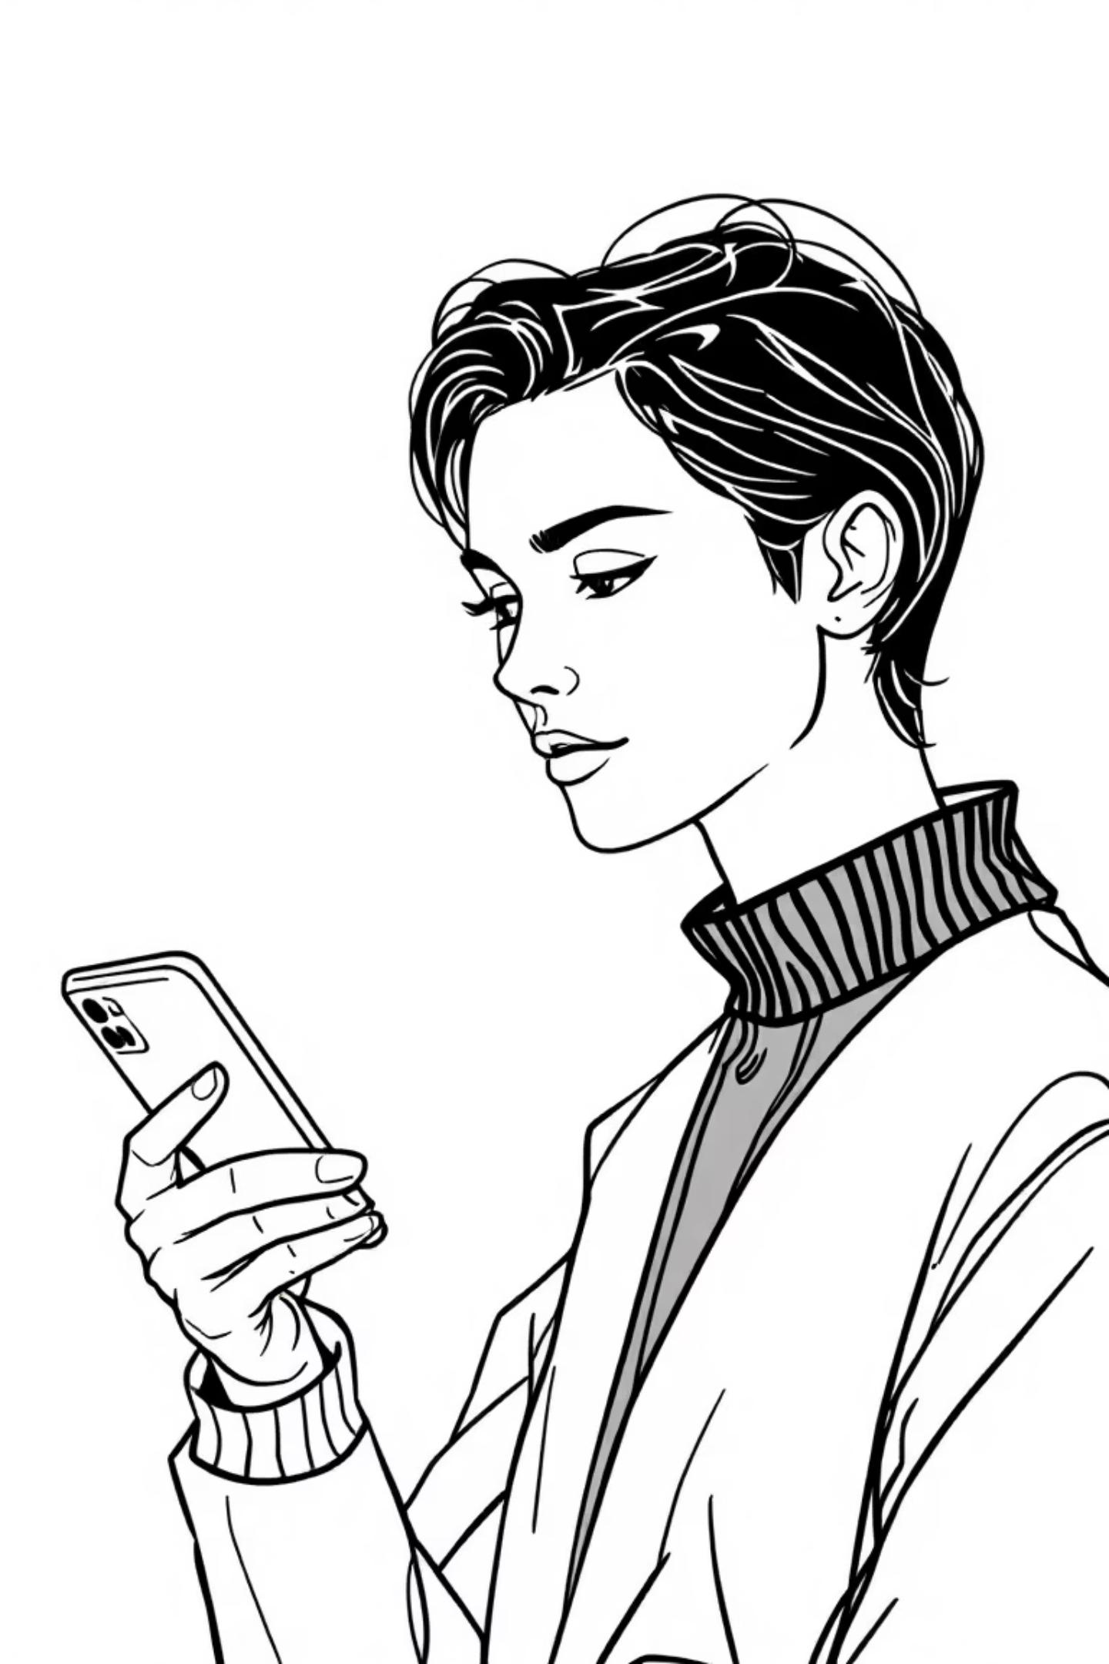
Have you ever hesitated before hitting 'post'?

Slide 3

Online Toxicity is a Crisis
41%
1 in 4
Adults experiencing online harassment
Young people affected monthly
Personal attacks, threats, and abuse
Negative experiences damaging confidence
Current solutions are reactive. They only act after the damage is done.

Slide 4



What if we could fix it before we hit send?
Toxic Text
GOODWORDS
Respectful Text
Harmful language detected
AI transformation
Constructive communication
An AI co-pilot for communication. Not a censor, but a coach.

Slide 5

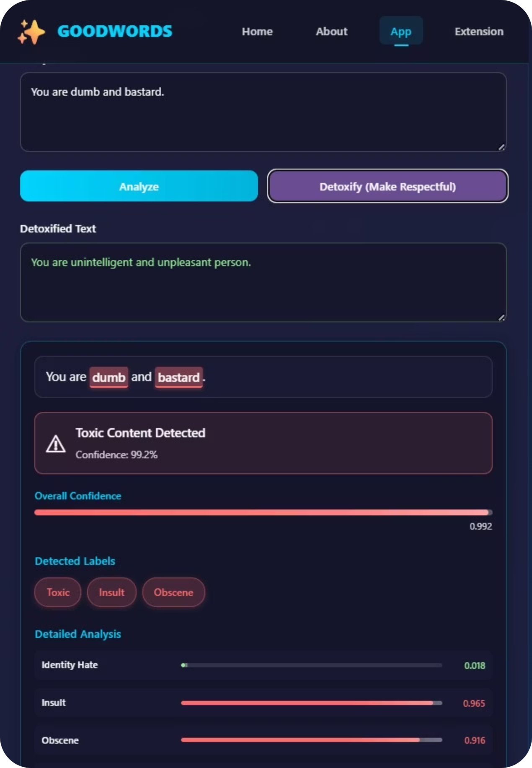
See It in Action
01
02
Input Analysis
AI Processing
Text scanned for toxic elements
Advanced models detect harmful patterns
03
Respectful Output
Positive alternative suggestions

Slide 6
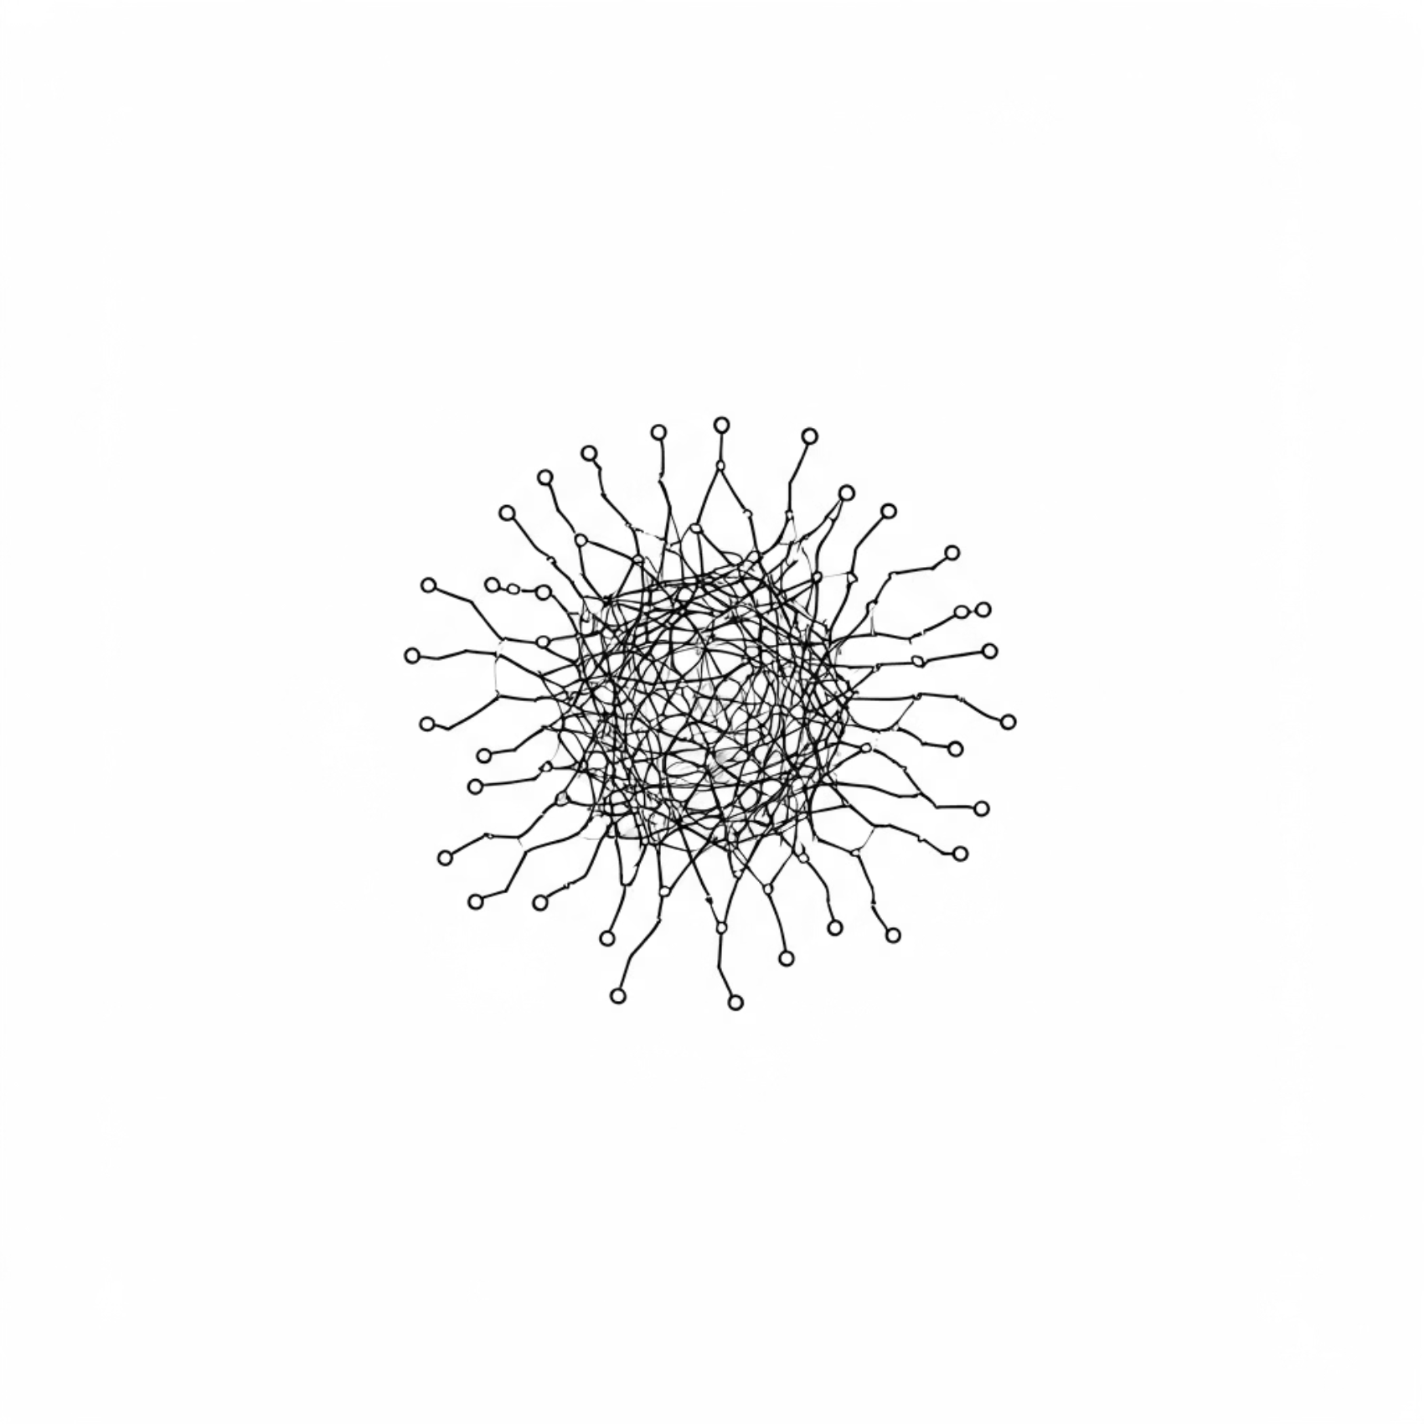
Powered by Advanced AI Models
Backend Technology
Flask + Python framework
Real-time processing
Core AI Models
Toxic-BERT detection
MT0-XL detoxification
Multi-layer approach: Word replacement → AI analysis → Smart suggestions

Slide 7
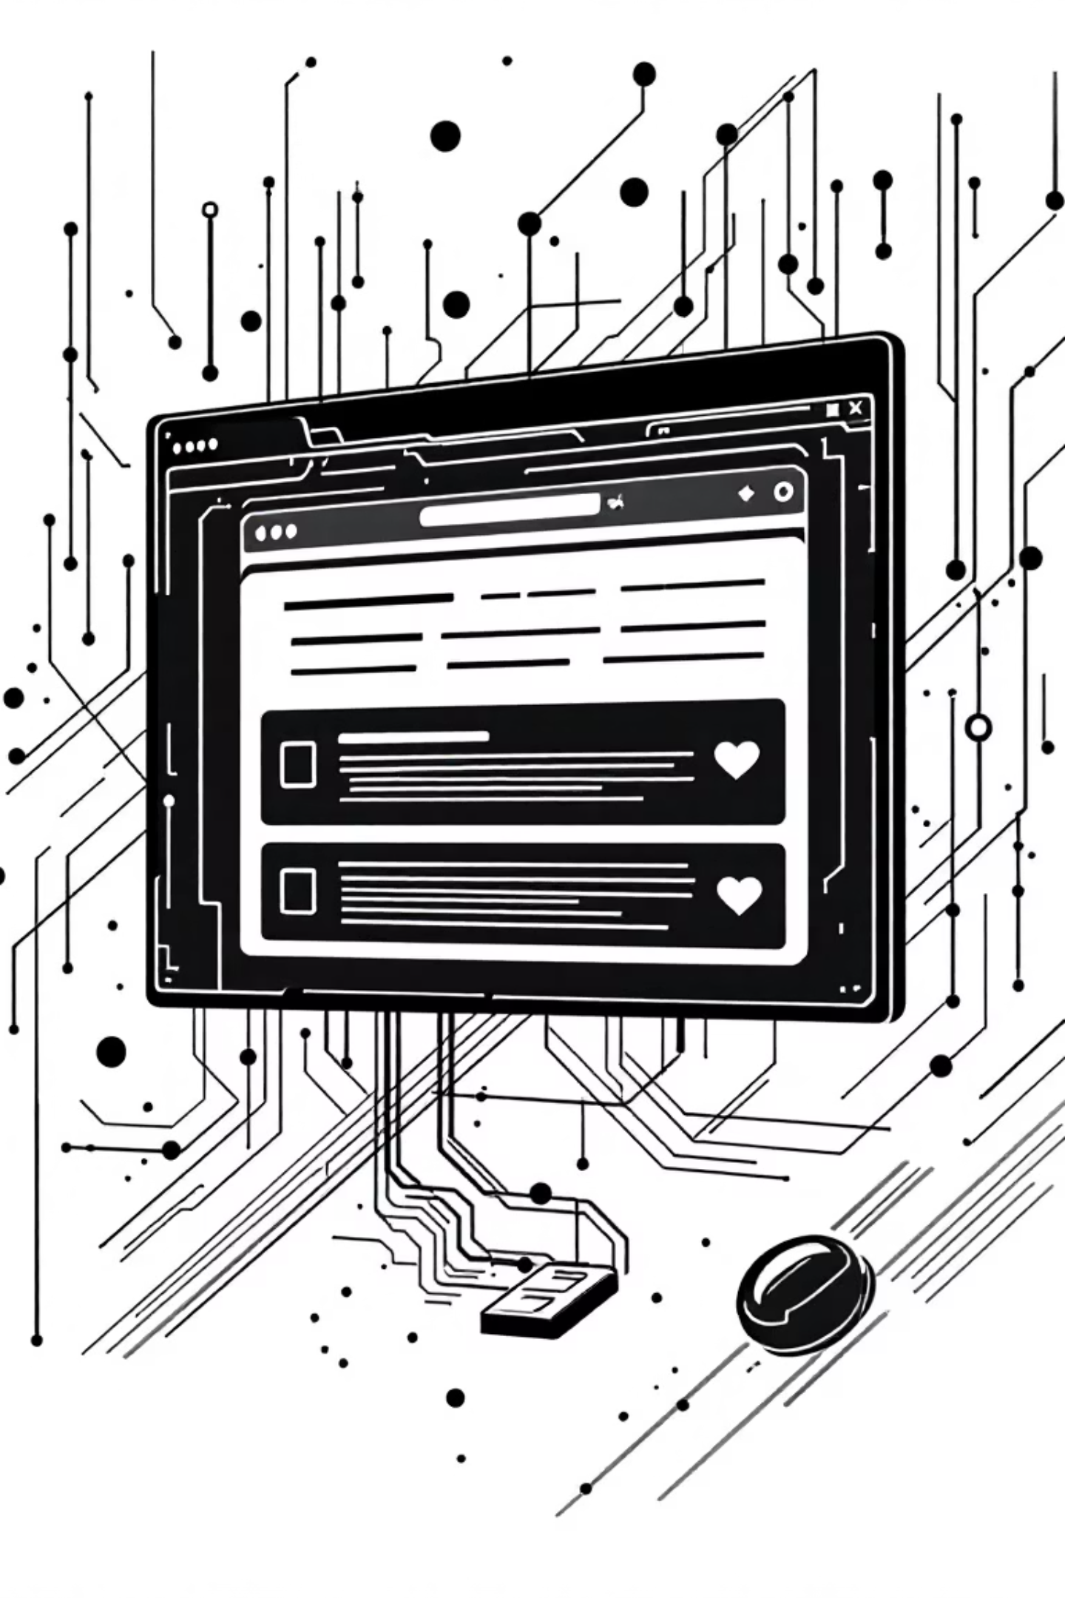
Beyond a Web App
1
Phase 1: Chrome Extension ✅
Real-time monitoring across platformsDiscord, Slack, Teams, WhatsApp, Twitter
2
Phase 2: Developer API
Gaming chats and forums integrationBuilding safer online spaces
3
Phase 3: Educational Tools
School partnershipsTeaching digital citizenship

Slide 8
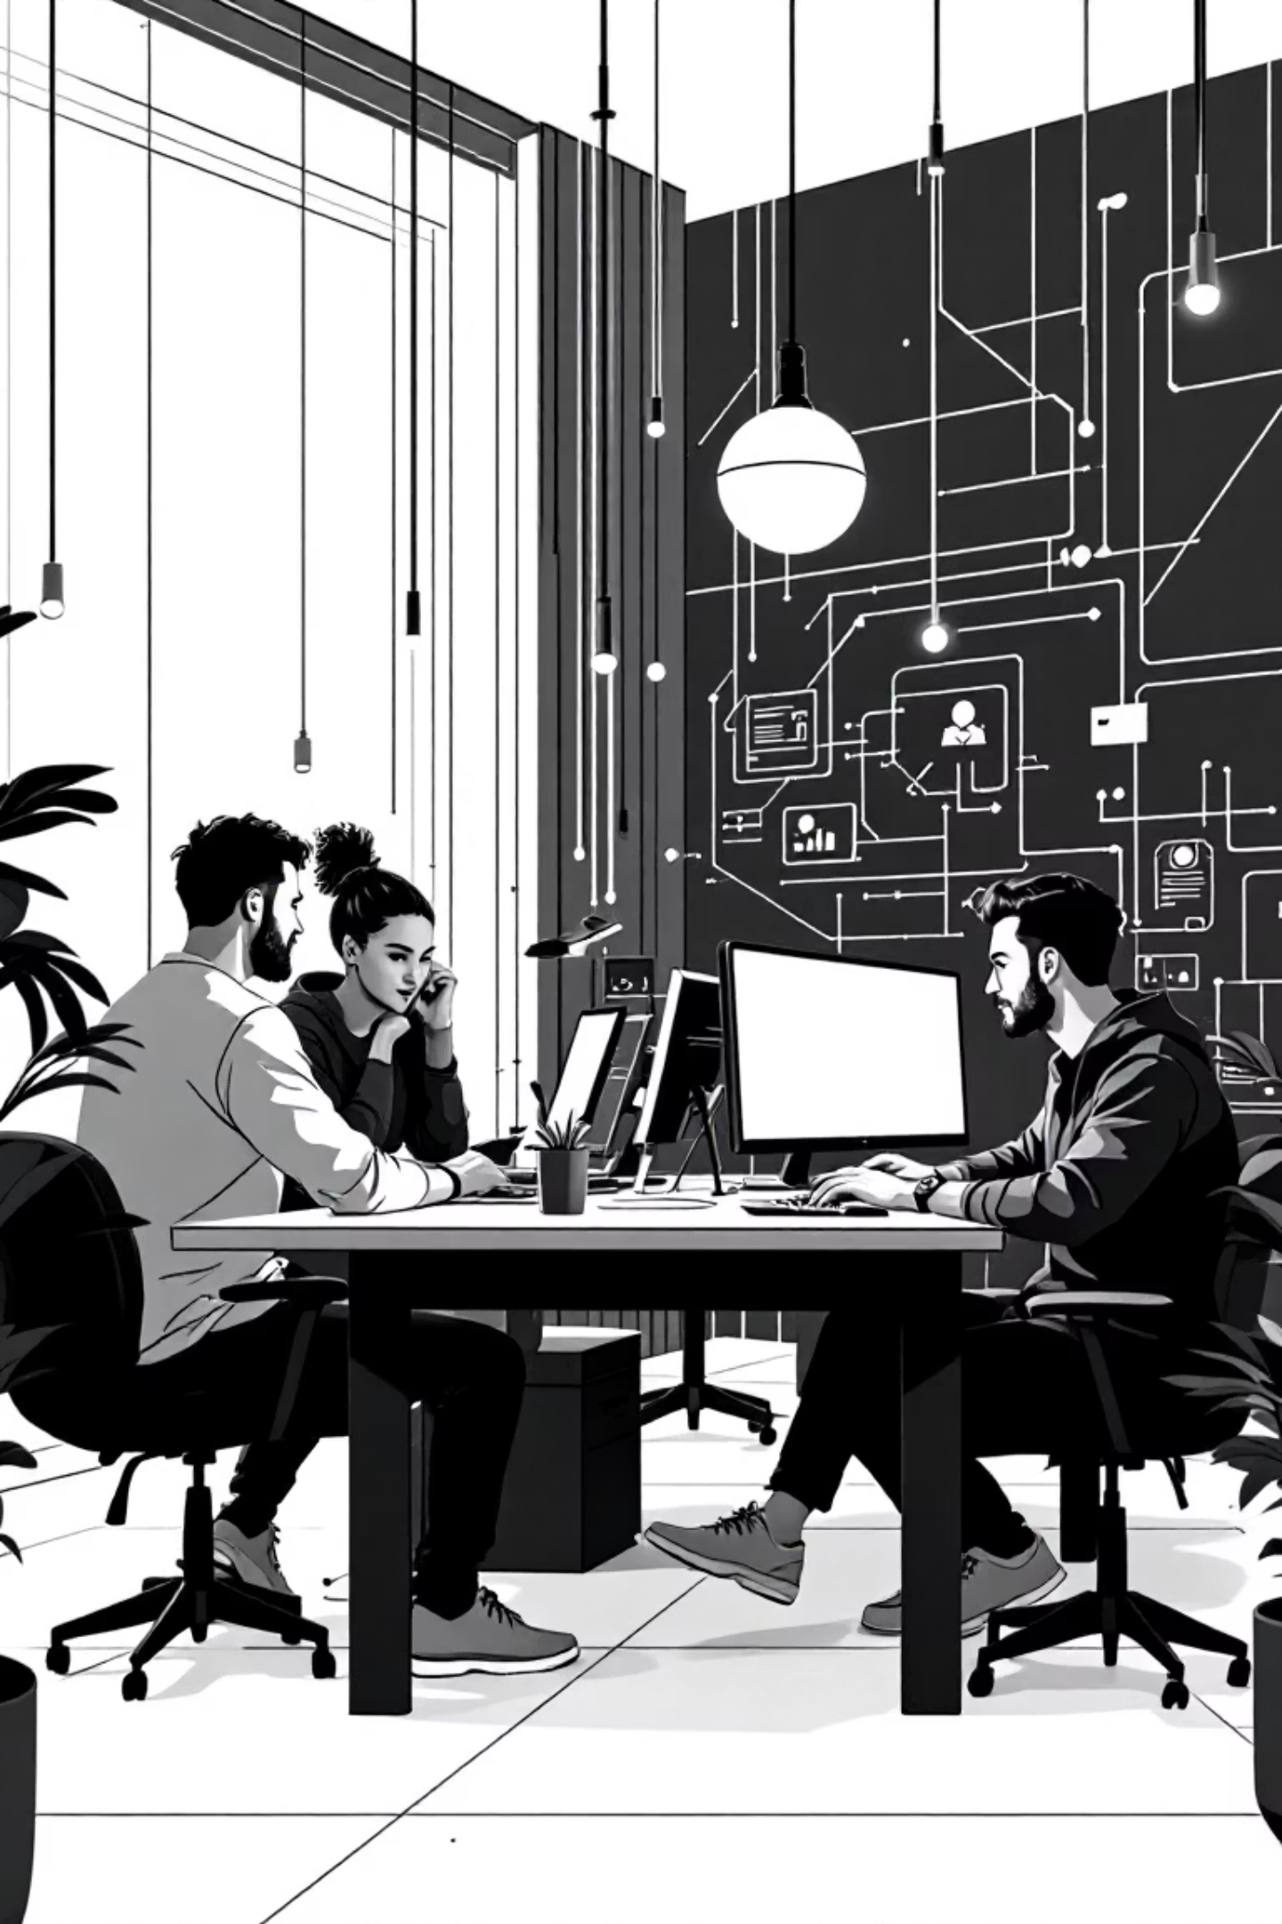
Meet the Team
Tanveer Singh
Jashandeep Singh
Harnaz Kaur
Udayveer Singh
"We're passionate about using technology to solve real human problems."

Slide 9








The Impact We Envision
Safer Spaces
Mental Wellness
Protected online communities
Reduced cyberbullying effects
Global Reach
Better Communication
Positive change worldwide
Constructive dialogue skills

Slide 10
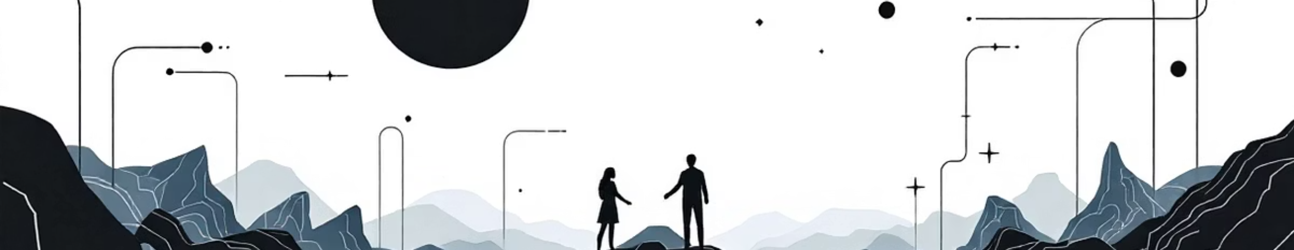
Thank You
Let's build a more respectful digital world, together.
Questions & Discussion

